Slide 1
Optimisation technique in C
ABHISHEK MOURYA
Batch-68

Slide 2
Table of Contents
Introduction
Why Optimization is needed
Who will do optimization
Optimization by programmer
How compiler do optimization
GCC flags
Optimization effect
Profiling tools
Disadvantage
Conclusion
Reference

Slide 3
Introduction
Optimisation is the process of modifying a piece of code such that it uses fewer resources and work more efficiently(time).
Optimisation is a technique which should not change the logical meaning of the code, but it will improve just one or two aspects of program.
(ex : execution time, memory usage, disk space, network bandwidth etc)

Slide 4
Why Optimization is needed ?
To reduce unnecessary code and increase the time of execution.
To reduce size of the code.
To reduces the redundancy.
Ex: Before Optimize
i * 2; var1 = i << 1 ;
var1 = 2 * i ;
var2 = i + i ;

Slide 5
Who will do optimization ?
Programmer – Optimization can be done by programmer during writing of source code.
Compiler – After the intermediate code is generated using TAC or 3AC method it uses large number of temporary variable to evaluate an expression. These temporary variables are reduced during optimization

Slide 6
Optimization by programmer...
There are two parameter on the basis of which a programmer can optimise the code.
1. Compute bound – Design level
- Code level
2. Memory bound – Compiler level

Slide 7
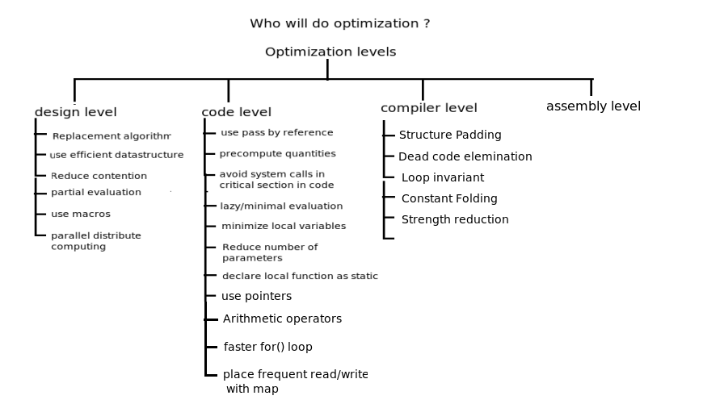
"Levels" of optimization

Slide 8
Optimization by programmer...
DESIGN LEVEL :
1) Replacement algorithms: Finding an iten in unsorted list time complexity is O(n).
- Replace binary search O(log n) with normal linked traverse.
- Replace Hashing O(1) with normal linked traverse O(n).
- Replace Quick sort O(nlog n) with Bubble or insertion sortO(n^2).
2) Parallel/Distributed computing: Dividing large task into smaller ones, which are executed parallel in multiple threads.

Slide 9
Continue...
3) Use efficient data structure : Data structure should be chosen based on data structure requirement .
- For sequential access list is better and for random access array is better (index),
Data structure type : when to use:
Array - Random access on finite element with an index
List - sequential access on infinite elements
Hash table - Random access on infinite elements on a key
Tree - Find largest, range browse alphabetically
4) Partial Evaluation : Replacing the generic function with a specialized function.

Slide 10
continue...
5) Reduce contention : Keep critical section as small as possible.
- if many threads reads shared data and rarely changes the value, then use read/write lock.
-Reduce the granularity of lock.
6) Cache frequently used data : Cache frequently accessed data which does not change.
7) Use macro to turn on/off debug messages : Prefer to use macros than condition checking to enable debugging.

Slide 11
continue...
CODE LEVEL
1) Use pass by reference for user define data type.
2) Pre-compute quantities to speed up run time calculation.
Ex :
For (int I = 0; I < 100; i++)
  Offset = offset + strlen(str) ;
  Shall be replaced
  Int size = strlen(str);
  For (int I = 0; I < 100; i++)
    offset = offset + size;

Slide 12
continue...
3) Avoid system calls in time critical section of code.
4) Lazy/Minimal evaluation : delaying a computation until the result of computation is actually needed.
Ex:
  If (strcmp(str,”SYSTEM”) && flag ==1) {
  //...
  }
  Shall be replaced :
  If (flag == 1 && strcmp(str, “SYSTEM”)) {
  //...
  }
  5) Minimize local variables

Slide 13
continue...
6) Reduce number of parameters.
7) Declare local function as static.
8) Avoid using global variables in performance critical code.
9) Replace frequent read/write with mmap.
10) Arithmetic Operator : Replacing multiplication and division by shift and add operation.
X*2 shall be replaced x+x or x<<1
x*n shall be replaced by x<<L where n is 2^L
X/n shall be replaced by x>>L where n is 2^L

Slide 14
continue...
11) Faster for() loops : If the code inside the loop dose 'nt care about the order of the loop counter we can do...
Ex: for (I = 0; I < 10; i++){....}// before
  For (I = 10; i--; ){....}//optimized
12) Prefer int over char and short.

Slide 15
continue...
COMPILER LEVEL
1) Structure Padding : If structure size is a power of 2, then it shall replace it with shift operation, which is faster.
2) Dead code elimination :
int foo(void)
{
int a = 24; int b = 25;/* Assignment to dead variable */int c;
c = a << 2;
return c;
b = 24; /* Unreachable code */
return 0;
}

Slide 16
continue...
3) Loop invariants : Expressions which are not changing in loop, should compute before loop starts.
Ex: for (int iter = 0; iter < 100; iter++){
    total = total + iter + val1 + val2; }
  Shall be replaced
  tmp = val1 + val2;
for (int iter = 0; iter < 100; iter++){
    total = total + iter + temp; }
  4) Constant Folding : int x = 100 * 5 sizeof(int);
  Compiler computes the value of constant expressions at compile time rather

Slide 17
Three Address Code
instructions are of the form ‘x = y op z,’ where x,
  y, z are variables, constants, or “temporaries”.
At most one operator allowed on RHS, so no
‘built-up” expressions. Instead, expressions are computed
using temporaries (compiler-generated variables).
Code snips :
Before THREE ADDRESS CODE :
if(a<b) 1. if (a<b) then goto 3
{ 2.go to next
x=x+1; 3.t1=x+1
} 4.x=t1
5.go to next

Slide 18
Three Address Code:
EXAMPLE:
_x0001_ Source:
if ( x + y*z > x*y + z)
a = 0;
Three Address Code:
tmp1 = y*z
tmp2 = x+t1 // x + y*z
tmp3 = x*y
tmp4 = t3+z // x*y + z
if (tmp2 > tmp4) goto L
a = 0

Slide 19
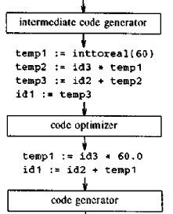
Optimization in compiler
Expression
pos := initial + rate * 60

Slide 20
How compiler do optimization
Using different level optimization can be done by the compiler.
GCC Optimization level
1. -O0 ( Default )
2. -O1 or -O
3. -O2
4. -O3
5. -Os

Slide 21
Continue...
-O0 : This is the default optimization level of the gcc compiler. At this level gcc does not perform any optimization.
Flag enable : No flag enable for this.
Code snippet :
Before THREE ADDRESS CODE :
if(a<b) 1. if (a<b) then goto 3
{ 2.go to next
x=x+1; 3 .t1=x+1
} 4.x=t1
        5.go to next

Slide 22
Continue...
O or -O1 :
The compiler tries to reduce code size and execution time,
without performing any optimizations.
The more expensive optimization, such as instructions scheduling, are not used at this level.
Flag : -floop-optimize – (Remove constant expression)
-ftree-dce - ( Dead code elimination)
-fomit-frame-pointer - ( Does not interfere debugging)

Slide 23
Continue...
DEAD CODE ELIMINATION:
Example :
int foo(void)
{
int a = 24;
int b = 25; /* Assignment to dead variable */
int c;
c = a << 2;
return c;
b = 24; /* Unreachable code */
return 0;
}

Slide 24
Continue...
-O2 :
increases compilation time and performance of the code.
It does not involve a space-speed tradeoff.
The compiler does not perform loop unrolling or function inlining.
Flag :
-foptimize-sibling-calls : ( Optimize tail recursive calls )
-fgcse : ( copy propagation )
Example of copy propagation
Unoptimized Optimize
tmp2 = tmp1 tmp3 = tmp2 * tmp1
tmp3 = tmp2 * tmp1 tmp5 = tmp3 * tmp2
tmp4 =tmp3 C= tmp5 – tmp4
tmp5 = tmp3 * tmp2
C= tmp5 – tmp4

Slide 25
Continue...
Tail recursion Elimination(TRE):-foptimize-sibling-calls
  TRE can take recursive function and turn it into whatever
  is the fastest form of loop for the machine.
int factorial(int num)//old code
{
if (num == 0) return 1;
else return num * factorial(num - 1);
}
int factorial(int num, int factor) //new code
{
if (num == 0) return factor;
else return factorial(num - 1, factor * num);
}

Slide 26
Continue...
Loop-unrooling :– Loop-unrooling is a method to optimize the loop.It is independent of the optimization.
Option used : -funroll-loops
Ex: for (i = 0; i < 100; i++) //old code
{
do_stuff(i);
}
for (i = 0; i < 100; ) //New code
{
do_stuff(i); i++;do_stuff(i); i++; do_stuff(i); i++;
do_stuff(i); i++; do_stuff(i); i++;do_stuff(i); i++;
do_stuff(i); i++;do_stuff(i); i++;do_stuff(i); i++;
do_stuff(i); i++;
}

Slide 27
Continue...
-O3 : turns on all optimizations specified by -O2 and also turns on the -finline-functions , -freename-register
Flag used :
-finline-functions
-frename-register
-funit-at-a-time
-Os :
This option reduce the size of an executable.
-Os enables all -O2 optimizations that do not typically increase code size.

Slide 28
GCC flags
-foptimize-sibling-calls
Optimize sibling and tail recursive calls.
-finline-functions
Integrate all simple functions into their callers.

Slide 29
Contd...
-fstrength-reduce
Loop strength reduction and elimination of
iteration variables.
-fmove-loop-invariants
Enables the loop invariant motion pass in
the new loop optimizer.
Ex: for (I = 0; I < 10; i++){....}// before
For (I = 10; i--; ){....}//optimized

Slide 30
Continue...
Strenght reduction:
Old code: x = w % 8;
y = pow(x, 2.0);
z = y * 33;
for (i = 0; i < MAX; i++) {
h = 14 * i;
printf("%d", h);
}
New code:
x = w & 7; /* bit-and cheaper than remainder */
y = x * x; /* mult is cheaper than power-of */
z = (y << 5) + y; /* shift & add cheaper than mult */
for (i = h = 0; i < MAX; i++) {
printf("%d", h);
h += 14; /* addition cheaper than mult */
}

Slide 31
Contd...
-funroll-loops
Unroll loops whose number of iterations can be
determined at compile time or upon entry to the
loop.
-floop-optimize
Move constant expressions out of loops.

Slide 32
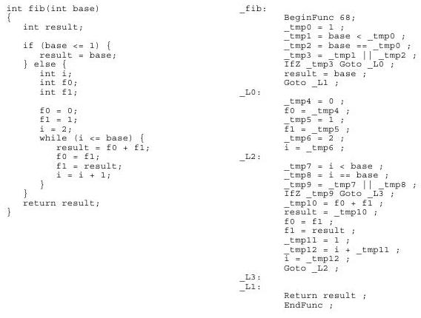
EXAMPLE
Fabinacci series Code

Slide 33
How to divide into the block
Basic block begin in several ways :
Entry point into the function.
The target of our branch.( in our example any label )
The instruction immediately follow a branch or a return.
End of basic block in any of given ways :
A jump statement.
A conditional and unconditional statement.
With return statement.

Slide 34
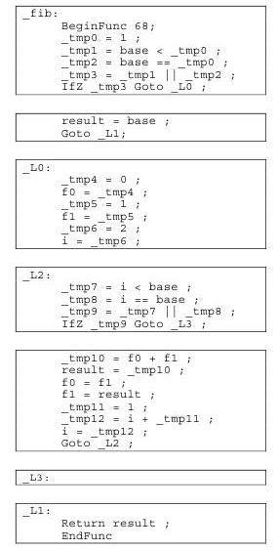
How compiler will divide into block..

Slide 35
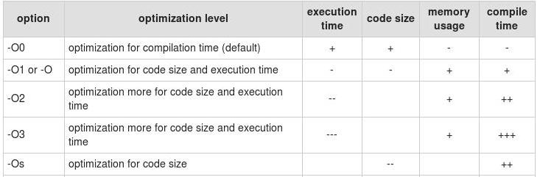
Optimization effect...
Performance summary :
+ increases ++ increases more +++ increase even more
- decrease -– decrease more --- decrease even more

Slide 36
Profiling Tools
Profiling : Profiling is a technique which gives you the distribution of time spent based on the functions defined in your program.
There are some tools and technique to get the distribution of time for your program.
1) Measuring tools : time command gives timing statics about the program that was run.
Ex : $time ./a.out
Real 0m0.024s
User 0m0.001s
Sys 0m0.023s
In above example 23 milliseconds for system calls, 1 milliseconds for user calls, total real time 24 milliseconds.

Slide 37
continue...
2) Getting resource usage of process :
Getrusage() function retrieves the resource used by the process using structure 'rusage'.
Syn : int getrusage(int process, struct rusage *res)
Where process shall be
RUSAGE_SELF – get statistics of current process
RUSAGE_CHILDREN – get statistics of child process
Struct rusage {
  Struct timeval ru_utime;// time spent for user instructions
  Struct timeval ru_stime;// tim for operating system code
  Long int ru_maxrss;// max physical memory used in KB
  ......
}

Slide 38
continue...
3) strace/itrace : It used to trace all the system calls made by the process. This is very helpful in case of debugging and to get a measure of where most of the time spent in our program.
Ex: main()
{
    FILE *fp = fopen(“file”,”w”);
    int I = 0;
    for (;i < 10000; i++) {
    fprintf(fp, “%d\n”, i);
    fflush(fp);
    }
    fclose(fp);
  }
  $gcc -O2 p1.c $strace -c a.out

Slide 39
continue...
% time seconds usecs/call calls errors syscall
100.00 0.000629 0 10000 write
0.00 0.000000 0 1 read
0.00 0.000000 0 3 open
0.00 0.000000 0 3 close
0.00 0.000000 0 1 execve
0.00 0.000000 0 1 1 access
0.00 0.000000 0 3 brk
0.00 0.000000 0 2 munmap
0.00 0.000000 0 1 mprotect
0.00 0.000000 0 7 mmap2
0.00 0.000000 0 3 fstat64
0.00 0.000000 0 1 set_thread_area
100.00 0.000629 10026 1 total

Slide 40
continue...
The above o/p says that write() system call is executed 10000 times.
Lets modify above program...
main()
{
    FILE *fp = fopen(“file”,”w”);
    int I = 0;
    for (;i < 10000; i++) {
    fprintf(fp, “%d\n”, i);
    }
    fflush(fp);
    fclose(fp);
  }
  $gcc -O2 p1.c $strace -c ./a.out

Slide 41
continue...
% time seconds usecs/call calls errors syscall
nan 0.000000 0 1 read
nan 0.000000 0 12 write
nan 0.000000 0 3 open
nan 0.000000 0 3 close
nan 0.000000 0 1 execve
Nan 0.000000 0 1 1 access
nan 0.000000 0 3 brk
nan 0.000000 0 2 munmap
nan 0.000000 0 1 mprotect
nan 0.000000 0 7 mmap2
nan 0.000000 0 3 fstat64
nan 0.000000 0 1 set_thread_area
100.00 0.000000 38 1 total

Slide 42
continue....
Some other utility also there in gcc to measure performance of our program....
Gprof : It identifies how much time is spent in a function.
Cachegrind : $valgrind –tool=cachegrind a.out
etc....

Slide 43
Disadvantage
optimization includes greater complexity in debugging
increased time and memory requirements during compilation

Slide 44
Conclusion
Optimization increase the efficiency of program.
Optimization can be done by programmers while writing the source code in design level, code level and compiler level.
Optimization can be done by done by compiler at compile time.

Slide 45
Reference
Compiler: Principles techniques and
Author:Alfred V. Aho, Ravi Sethi, Jeffrey D Ullman
Csystem : programming at the root...
Author : Susant K Rout and T prabakaran
man gcc
http://leto.net/docs/C-optimization.php

Slide 46
Thank You

